Slide 1
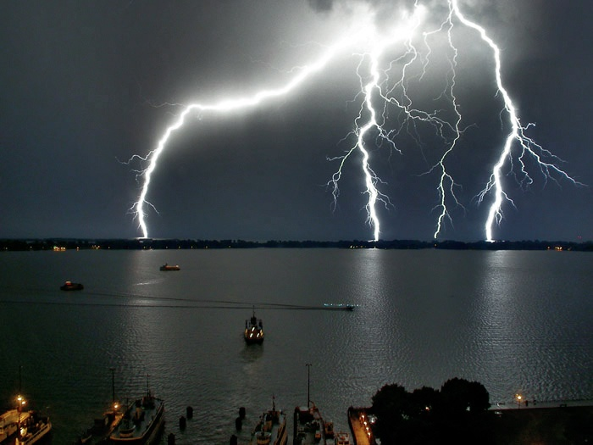
Electric Field

Slide 2
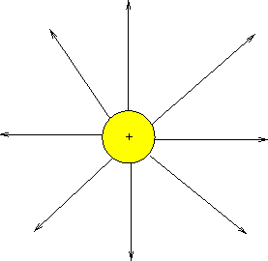
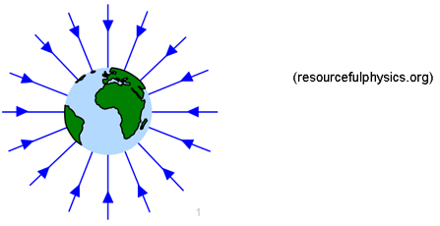
Analogy
The electric field is the space around an electrical charge
just like
a gravitational field is the space around a mass.

Slide 3
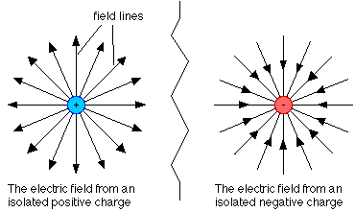
Electric Field
Space around a charge.

Slide 4
What is the difference?

Slide 5
Electric Field Vector, E
Electric Field is designed as follows
E = F/ q_{o}
q_{o ,} positive test charge
E is a vector quantity
  Direction indicated by small + test charge
Unit: N/C
E is analogous to the gravitational field, g, where g=F/m
Notes:
The electric field is a vector field; it consists of a distribution of vectors, one for each point in the region around a charged object, such as a charged rod. In principle,
we can define the electric field at some point near the charged object, such as point P as follows: We first place a positive charge q0, called a test
charge, at the point. We then measure the electrostatic force that acts on the test charge. Finally, we define the electric field at point P due to the charged object as

Slide 6
Example 1
A charge of 3µC is used to test the electric field of a central charge of 6C that causes a force of 800N. What is the magnitude of the electric field?
Hint… Which charge ‘tests’ the field
Answer: 2.7 x10⁸ N/C

Slide 7
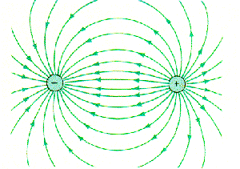
Electric Field Lines

Slide 8
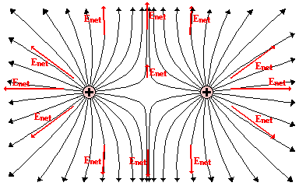
Electric Field Lines of two Positive Charges

Slide 9
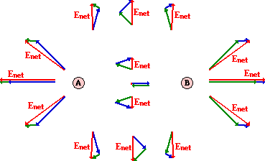
Electric Field Lines of two Positive Charges

Slide 10
Electric Field Lines
Michael Faraday introduced the idea of electric fields in the 19th century
The space around a charged body as filled with lines of force called electric field lines
Although we no longer attach much reality to these lines
Still provide a nice way to visualize patterns in electric fields
Notes:
A tangent line is a line that touches a curve at a single point and does not cross through it.

Slide 11
Electric Field Lines
The relation between the field lines and electric field vectors is:
At any point, the direction of a straight field line or the direction of the tangent to a curved field line gives the direction of at that point

Slide 12
Electric Field Lines
2. the field lines are drawn so that the number of lines per unit area, measured in a plane that is perpendicular to the lines, is proportional to the magnitude of E.Thus, E is large where field lines are close together and small where they are far apart.

Slide 13
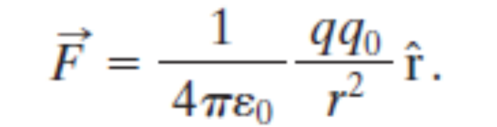
The Electric Field Due to a Point Charge
To find the electric field due to a point charge q at any point a distance r from the point charge, we put a positive test charge q0 at that point.
From Coulomb’s law the electrostatic force acting on q0 is

Slide 14
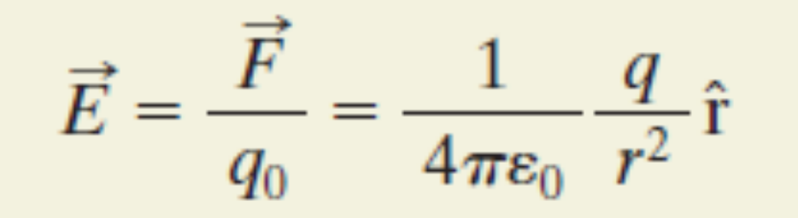
The Electric Field Due to a Point Charge
direction of E is the same as that of the force on the positive test charge:
directly away from the point charge if q is positive, and toward it if q is negative.

Slide 15
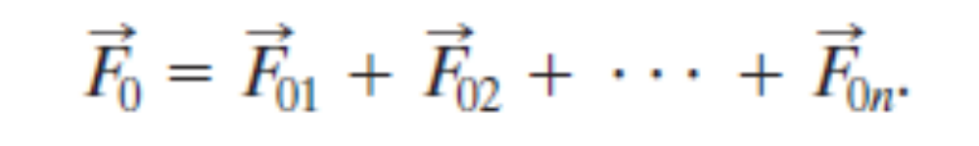
The Electric Field Due to a Point Charge
If we place a positive test charge q0 near n point charges q1, q2, . . . , qn, then, the net, or resultant, electric field due to more than one point charge.

Slide 16
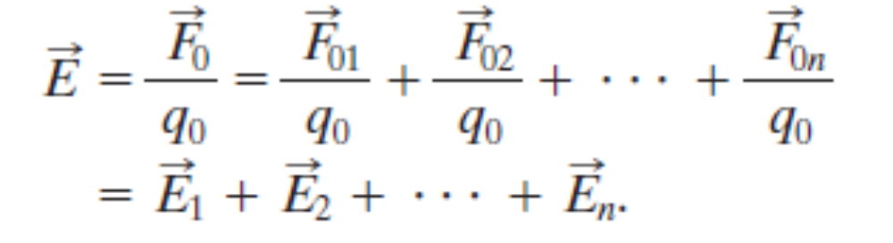
The Electric Field Due to a Point Charge
Therefore, the net electric field at the position of the test charge is
It shows that the principle of superposition applies to electric fields as well as to electrostatic forces
Notes:
states that, for all linear systems, the net response caused by two or more stimuli is the sum of the responses that would have been caused by each stimulus individually.

